Slide 1
A6 – Final Presentation
Members: Charlie Cox, Addison Snelling

Slide 2
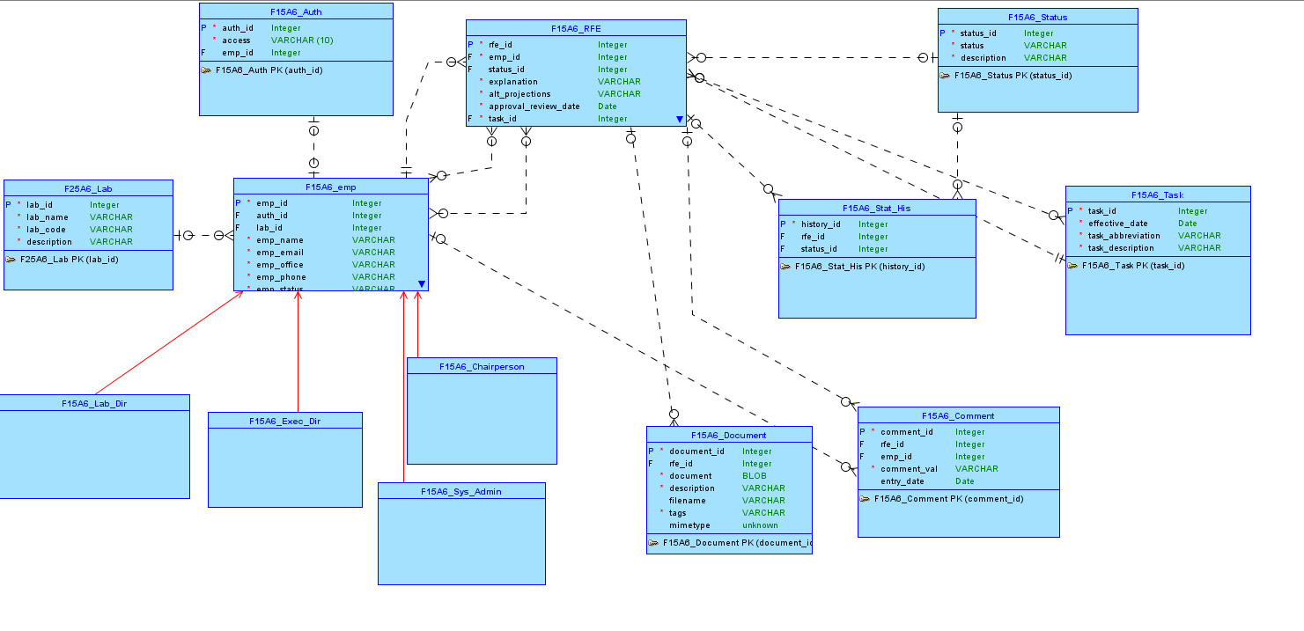
Conceptual Model

Slide 3
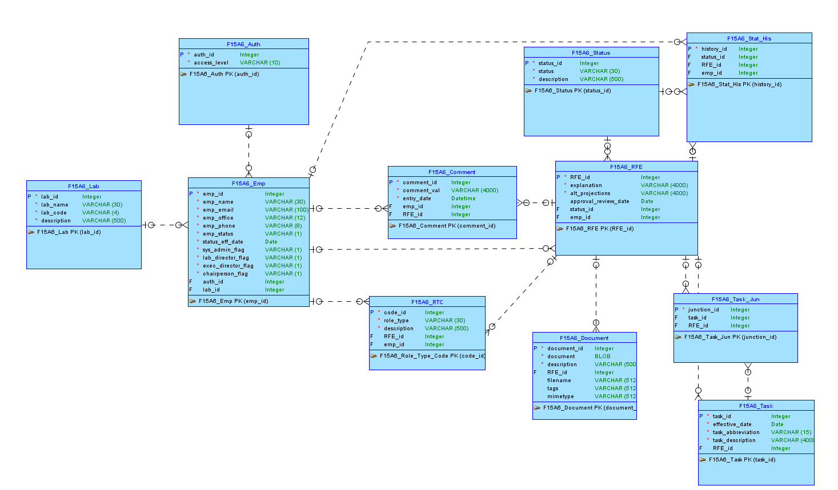
Logical Model

Slide 4
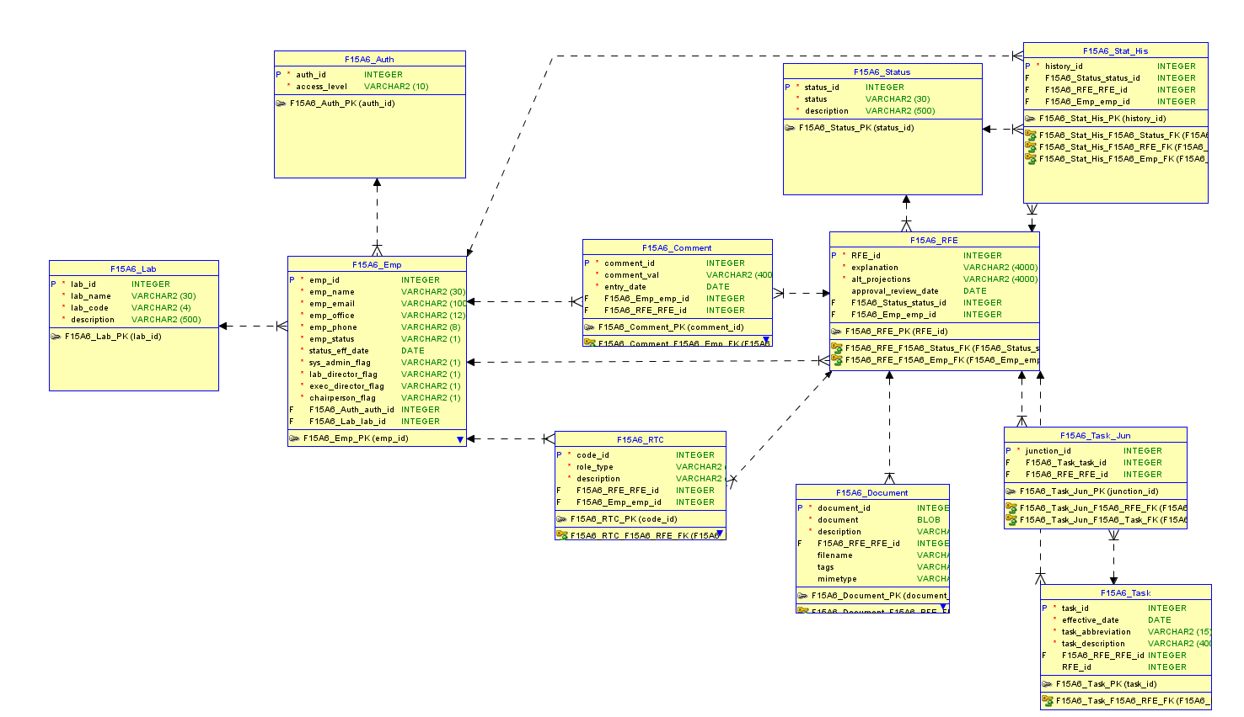
Relational Model

Slide 5
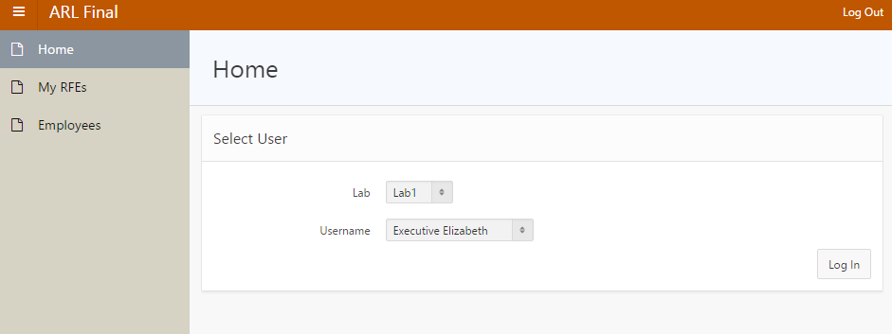
Screenshots

Slide 6
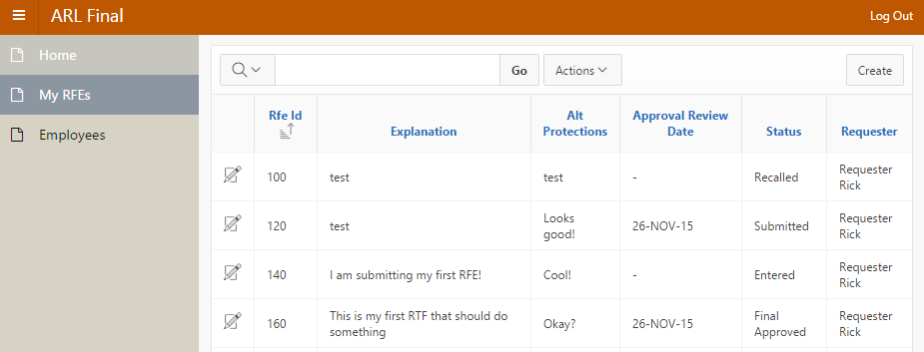
Screenshots

Slide 7
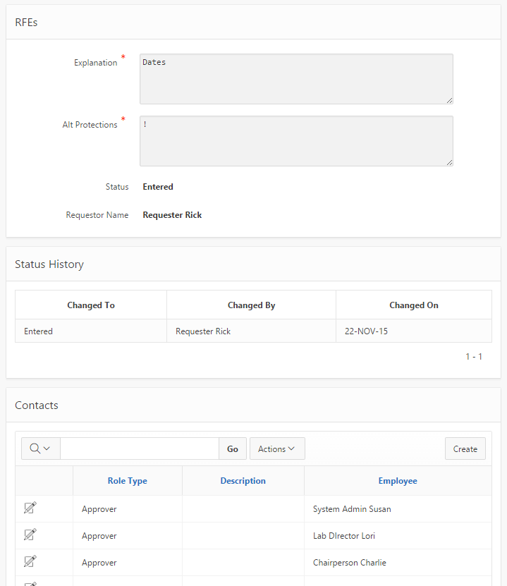

Slide 8
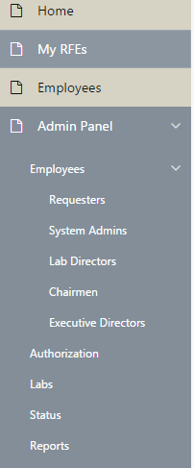
Screenshot

Slide 9
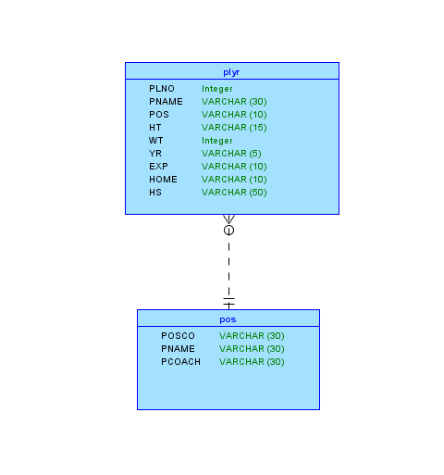
Part II Conceptual

Slide 10
Description
Originated from: At football games many people get programs then throw them on the ground. What if the program was on your phone, thus reducing litter?
Features: Search by player stats, search by coach stats, find out which player plays for which coach.

Slide 11
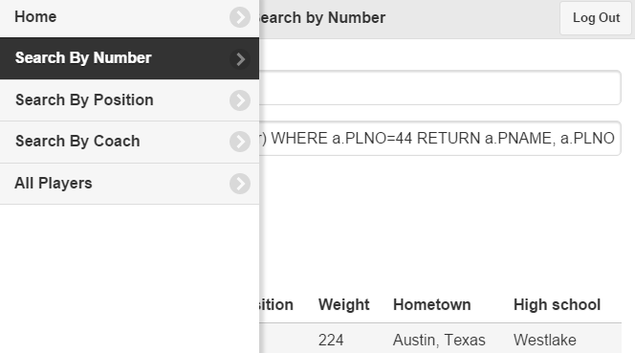
Screenshots

Slide 12
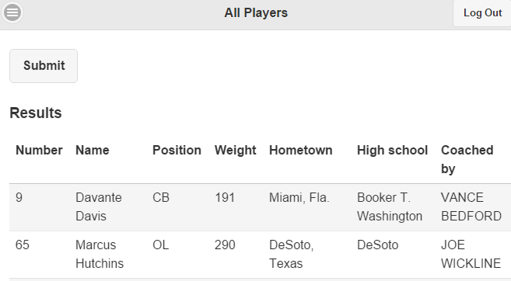
Screenshots

Slide 13
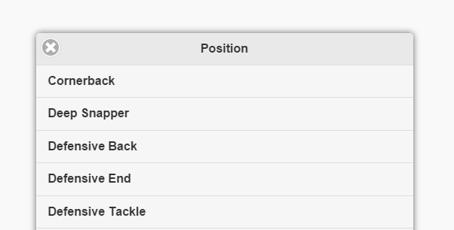
Screenshots

Slide 14
GitHub Repository
Gitrepo

